Slide 1
CAPSTONE PROJECT – CREDIT CARD FRAUD DETECTION
-By AVLEEN SINGH

Slide 2
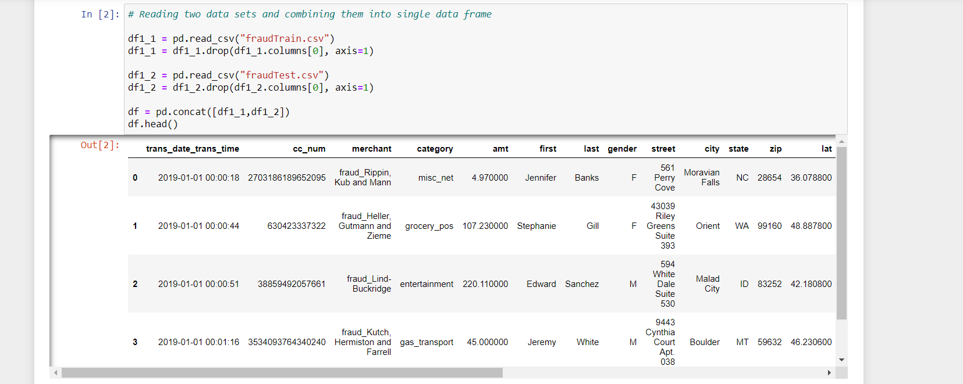
Reading of Data Set
In this Project, I have combined the 2 datasets (fraud train and fraud test) into 1 dataframe.

Slide 3
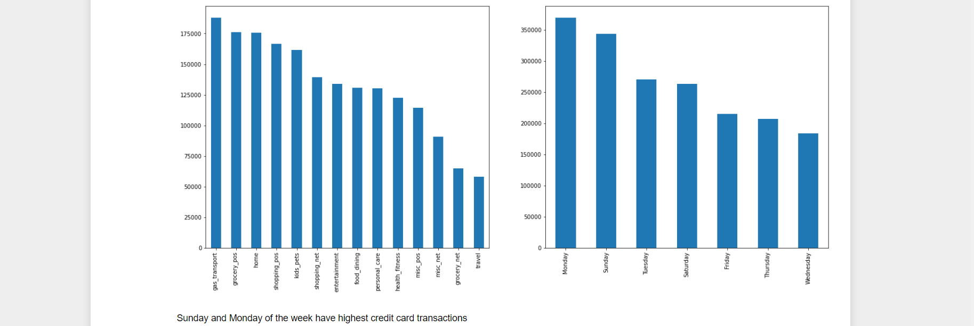
Important graphs performed in EDA
Plotted a graph between day_of_week and the different categories.
Sunday and Monday of the week have highest credit card transactions.

Slide 4
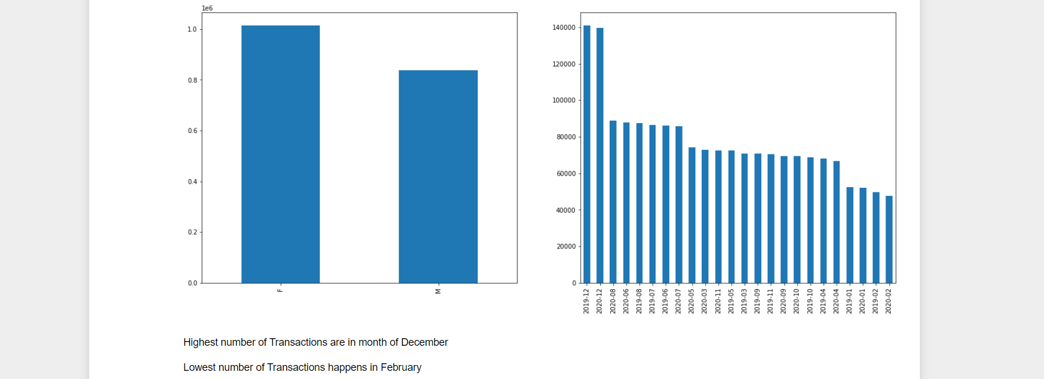
Gender vs year_month
Highest number of Transactions are in month of December 2019
Lowest number of Transactions happens in February 2020

Slide 5
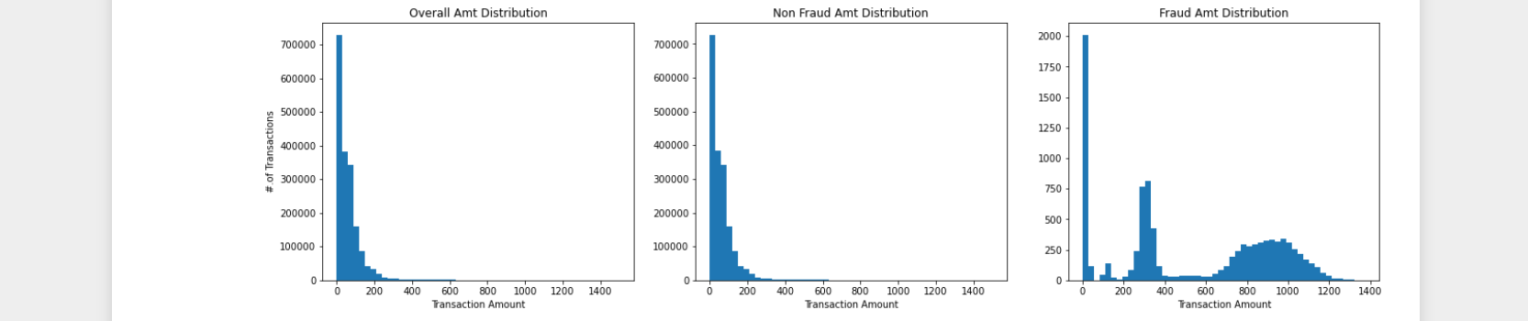
Amt vs is_fraud

Slide 6
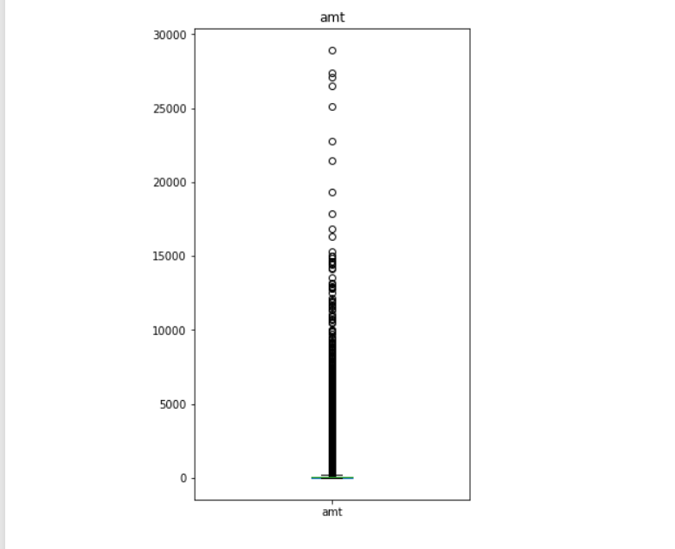
Box plot for Amt column

Slide 7
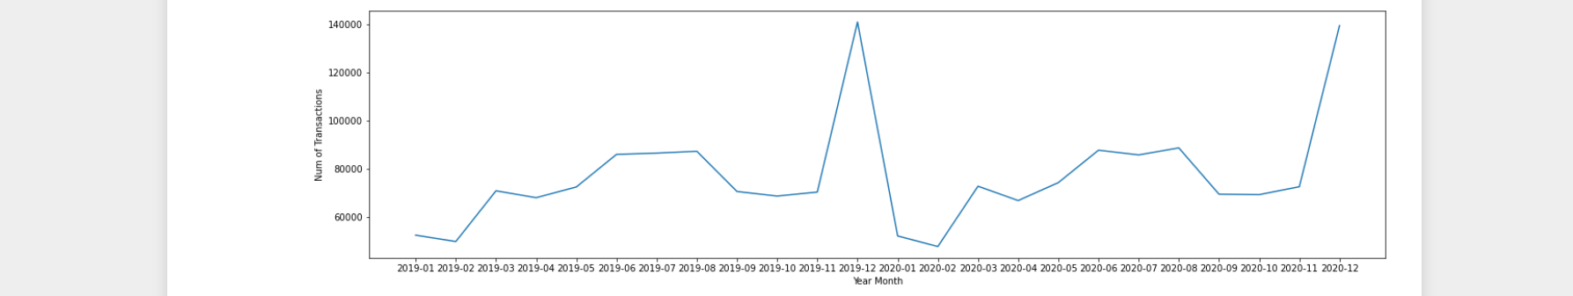
Num_transactions vs year_month

Slide 8
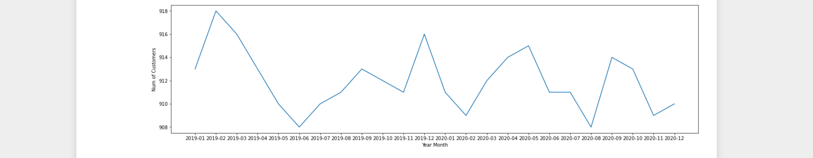
Num_of_customers vs year_month

Slide 9
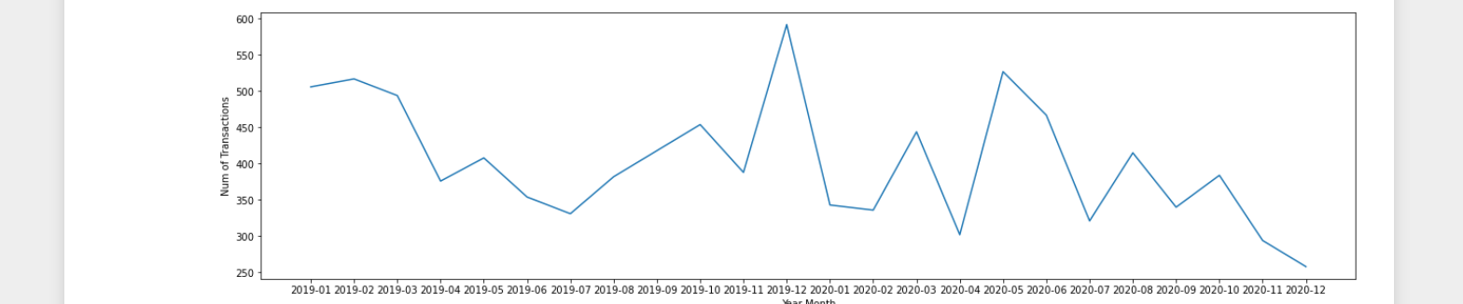
Num_of_fraud_transactions vs year_month

Slide 10
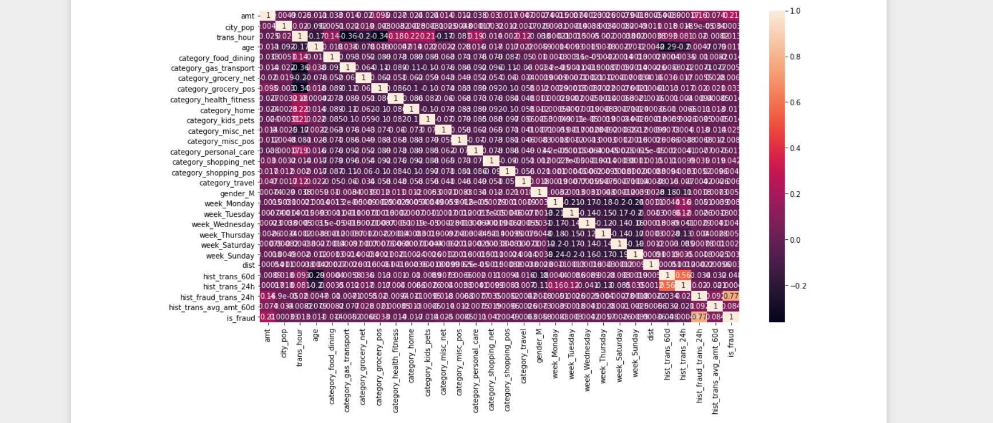
Heatmap of Correlation
hist_fraud_trans_24h is highly correlated with is_fraud - 0.77
hist_trans_24h is also correlated with hist_trans_60d - 0.56

Slide 11
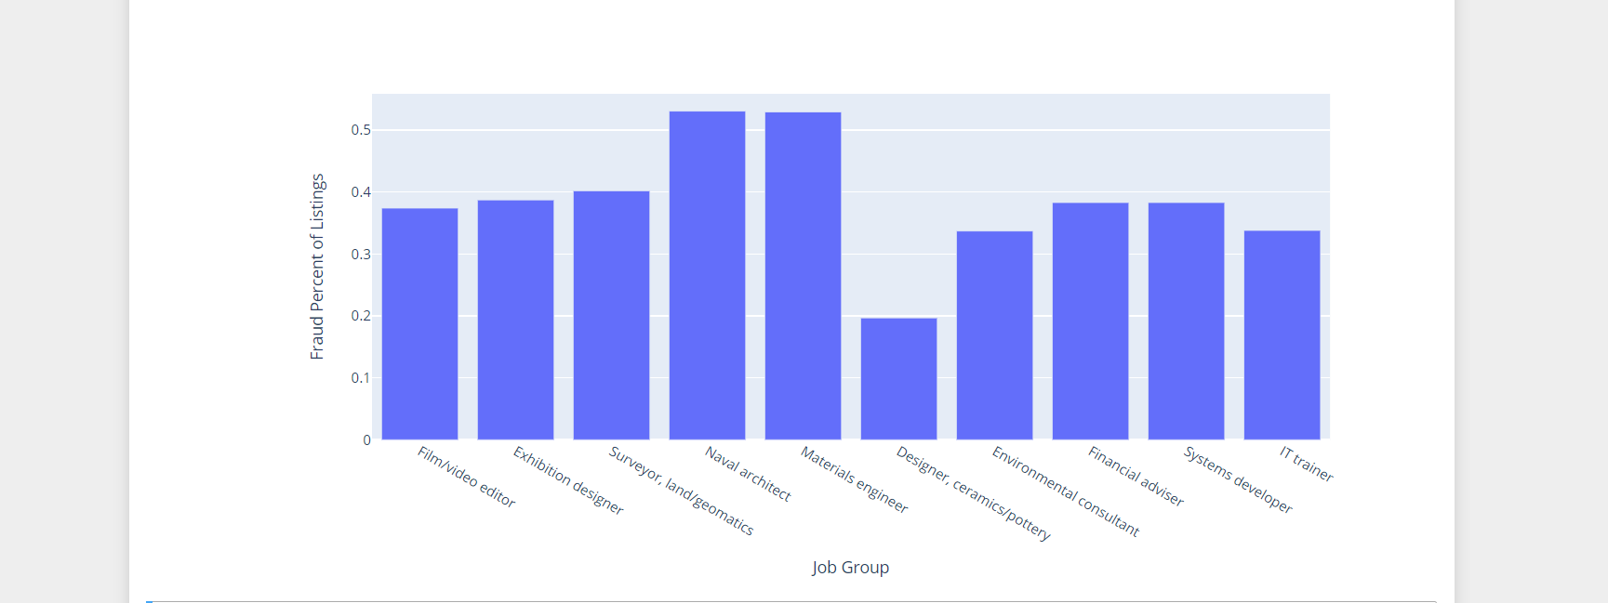
Transaction Amt Distribution Based on City, Age and Gender

Slide 12
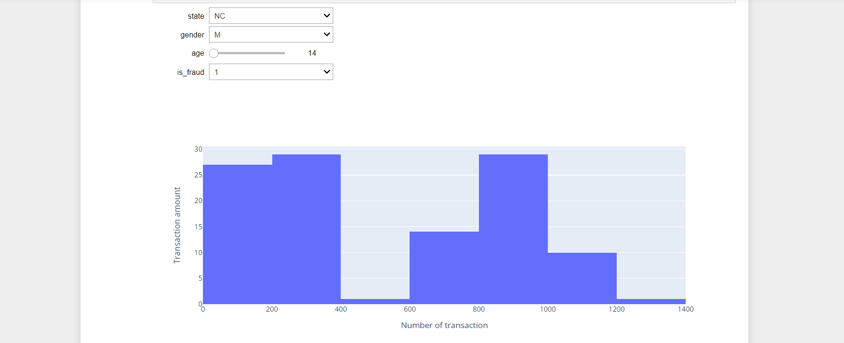
Number_of_transaction vs transaction_amt

Slide 13
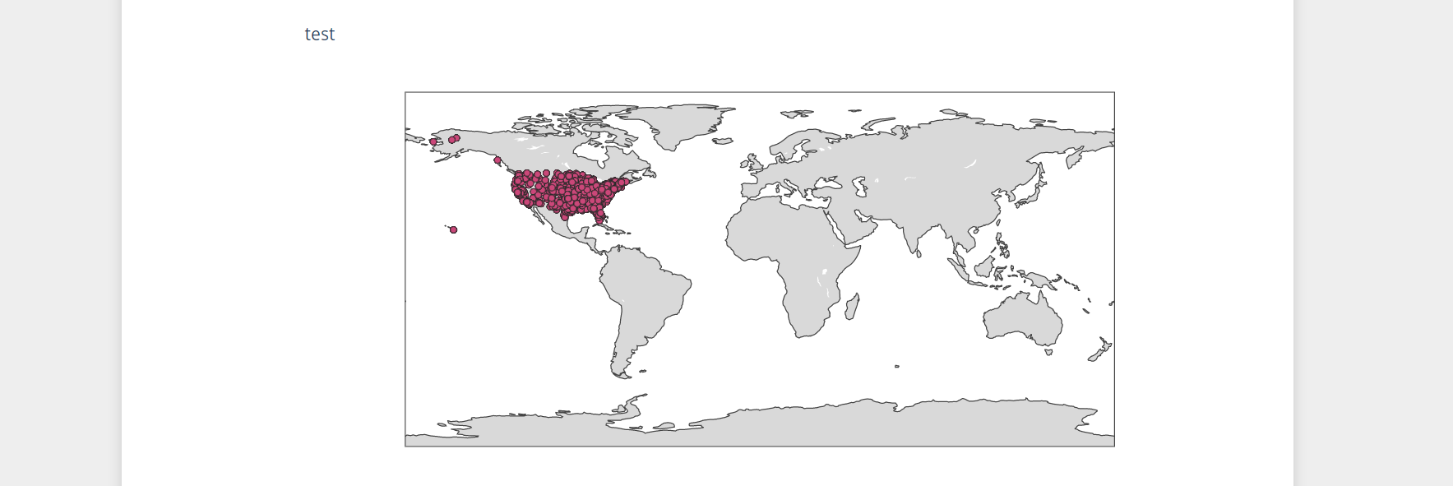
Plotting Fraudulent Transactions in the Map

Slide 14
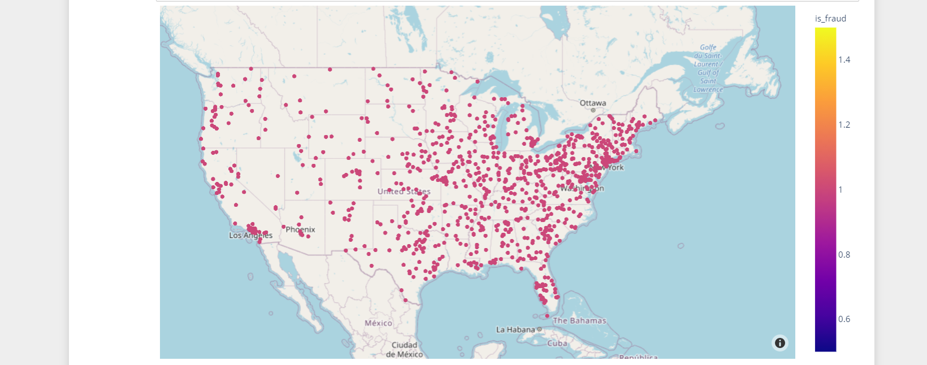
Distribution of fraud customers region wise

Slide 15
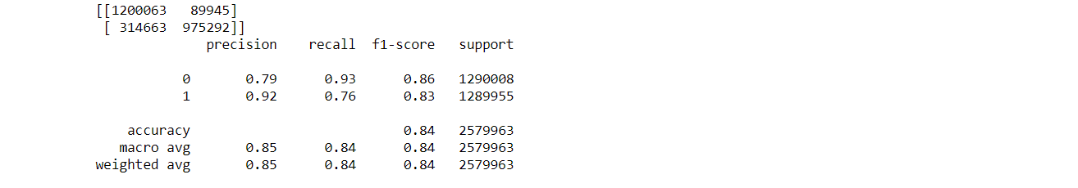
Logistic regression for modelling
Split the dataset into train and test sets and performed the steps for logistic regression.
Train set results

Slide 16

Test set results

Slide 17
Logistic Regression model results
Training data:
Accuracy - 84%
recall - 76%
Testing data:
Accuracy - 84%
recall - 76%

Slide 18


Decision tree
Building Decision Tree Model.
Train set results
Test set results

Slide 19
Decision tree model results
Training data:
Accuracy - 100%
recall - 100%
Testing data:
Accuracy - 100%
recall - 100%

Slide 20
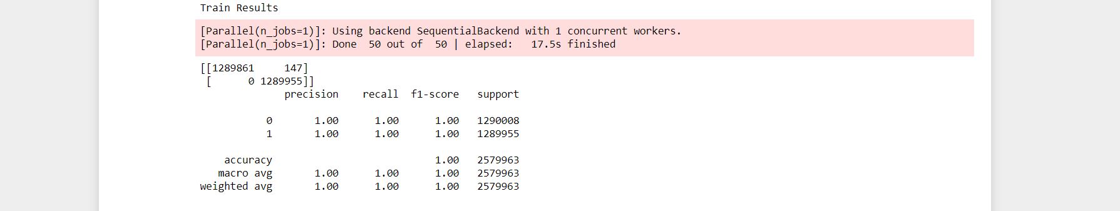
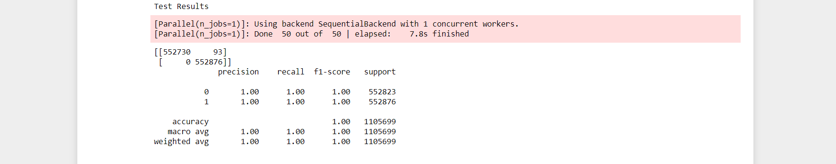
Random forest classifier
Building Random Forest Classifier model.
Train set results
Test set results

Slide 21
Random forest classifier results
Training data:
Accuracy - 100%
recall - 100%
Testing data:
Accuracy - 100%
recall - 100%

Slide 22


Gradient Boosting Trees modelling
Building Gradient Boosting Trees model.
Train set results
Test set results

Slide 23
Gradient Boosting Trees results
Training data:
Accuracy - 99%
recall - 98%
Testing data:
Accuracy - 99%
recall - 98%

Slide 24
Conclusion for model selection
On completing the 4 different types of modelling, I have come to a conclusion that the following 2 models would be the best models for use.
Decision Tree Model
Random Forest Classifier Model
I chose these 2 models because they have the highest accuracy as well as recall value as compared to the other models.

Slide 25
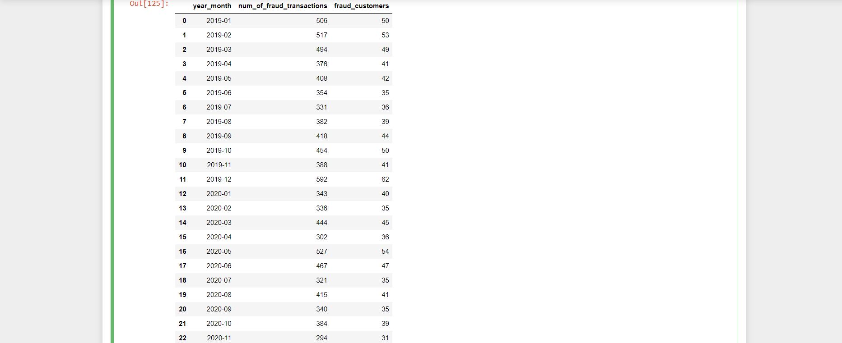
Cost benefit analysis
Monthly number of fraud transactions
The value was coming out to be 77,183.08

Slide 26
Average number of transactions by month

Slide 27

Conclusion
There are a total of 9651 out of 1852394 that are fraud.
In this dataset, it has a total of 24 months which on average has 402.125 frauds per month.
Decision Tree Model and Random Forest Classifier Model are the models who could be best used for fraud detection because it has 100% recall and accuracy values.

Slide 28
THANK YOU

